Slide 1
Tuesday,
November 3, 2020

Slide 2
v
Check your voter registration
Register to vote online
Last day to register to vote is Saturday, October 24, 2020 .
There will be a special voter registration session at Westwood Town Hall from 2:00PM-4:00PM and 7:00PM-8:00PM. All social distancing guidelines will be strictly enforced.

Slide 3
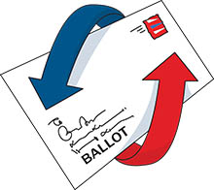
THREE OPTIONS TO VOTE
1. BY MAIL
Submit an application to the Town Clerk’s office no later than October 29, 2020.
Applications are available in the lobby at the Westwood Police Station, 588 High Street.
By contacting the Town Clerks office, 781-320-1013/781-320-3964 or votebymail@townhall.westwood.ma.us
Or by applying online.

Slide 4
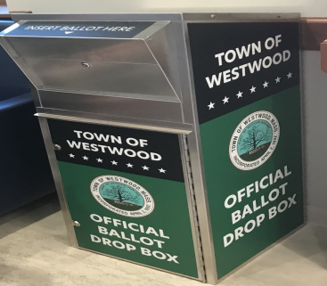
Ballots will be mailed out this week to any voter who has submitted a request.
You may return your Ballot by mail .
Or in the secure Ballot Drop Box which will located in front of the Westwood Police Station.
To check the status of your mail in Ballot.

Slide 5
Ballots that are returned by mail must be postmarked no later than November 3, 2020 and received no later than November 6, 2020 to be added to the Election results.
These ballots will processed on Saturday, November 7th at 9:00AM in the office of the Town Clerk by the Town Clerk and the Board of Registrars.
Any voter who has returned an early or absentee ballot that has been accepted cannot vote in person on Election Day.

Slide 6
2. Early Voting in Person Jaillet Meeting Room Westwood Police Station, 588 High Street
Saturday, October 17th | 9:00 am to 1:00 pm
Sunday, October 18th | 9:00 am to 1:00 pm
Monday, October 19th | 9:00 am to 4:00 pm
Tuesday, October 20th | 9:00 am to 7:00 pm
Wednesday, October 21st | 9:00 am to 4:00 pm
Thursday, October 22nd | 9:00 am to 4:00 pm
Friday, October 23rd | 9:00 am to 1:00 pm
Saturday, October 24th | 12:00 pm to 4:00 pm
Sunday, October 25th | 11:00 am to 3:00 pm
Monday, October 26th | 9:00 am to 4:00 pm
Tuesday, October 27th | 9:00 am to 7:00 pm
Wednesday, October 28th | 9:00 am to 4:00 pm
Thursday, October 29th | 9:00 am to 4:00 pm
Friday, October 30th | 9:00 am to 1:00 pm

Slide 7
3. Vote in Person
Polls will all be set up in accordance with all COVID-19 precautions for the safety and wellbeing of staff and voters.
As with all elections that have taken place this year, we will continue to highly encourage all voters to wear facial coverings when going to vote. Please be considerate of your neighbors by following this important public health guideline.

Slide 8
Polling Locations are as follows:
Pct 1-Council On aging, 60 Nahatan Street
Pct 2-Sheehan School-549 Pond Street
Pct 3-Hanlon School-790 Gay Street
Pct 4-Downey School-250 Downey Street
To check your polling location
Or contact my office at 781-320-1013/781-326-3964 or townclerk@townhall.westwood.ma.us

Slide 9
Please do not hesitate to reach out to me with any questions you may have concerning the upcoming Election. I want to ensure our citizens that your vote is very important and we take the democratic process very seriously in Westwood always working diligently to ensure every vote is private and secure at all times and counted on Election Day.

